Slide 1
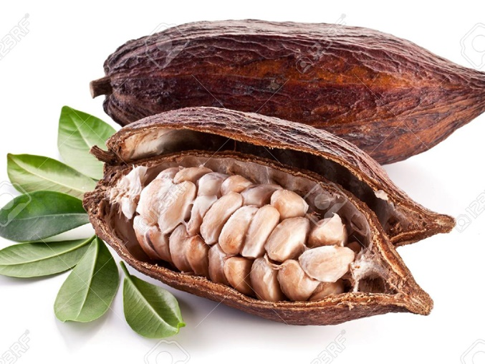
Julia Christian, Fern Towards sustainable cocoa supply chains: Regulatory options for the EU European Parliament, Brussels, 5 November 2019

Slide 2
3 facts about cocoa

Slide 3
1. Cocoa is driving rapid & devastating rainforest loss
Forest cover in Cote d’Ivoire, 1990-2015

Slide 4
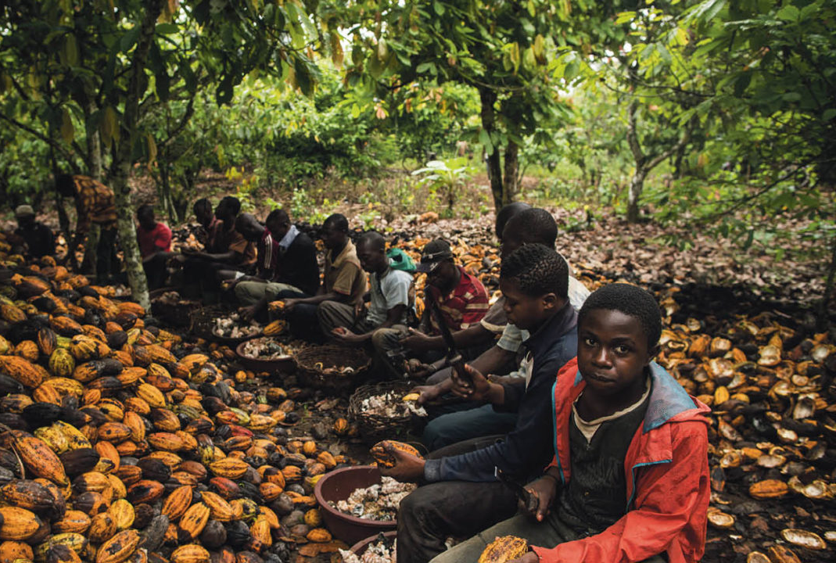
2. There are over 2 million children working in cocoa
And this number is still increasing, despite voluntary company commitments to end child labour taken almost 20 years ago…

Slide 5
3. Europe’s responsibility is huge
We are the largest processor & consumer of cocoa too.

Slide 6
By Duncan Brack (June 2019)
Aim of the report: detail what regulatory actions the EU could take, in partnership with producer countries, to address deforestation & poverty in cocoa production
Paper outlines eight options.
Focus on cocoa, but in principle options applicable to any forest risk commodity

Slide 7
Option A: Bilateral agreements
Bilateral agreement EU – producer country
Modelled on FLEGT Voluntary Partnership Agreements
How would it work?
Start with coming up with, via a multi-stakeholder dialogue, a national definition for what is sustainable cocoa (should it be just based on national law, or higher international standards)?
Then put in place national traceability system to ensure that all exported cocoa is sustainable
EU provides technical, financial support etc.

Slide 8
Options G & H: Due diligence regulation
Option G: specific to cocoa and/or forest risk commodities
Existing models: EU Conflict Minerals Regulation, EU Timber Regulation (DD elements)
Option H: covers all companies, regardless of sector
Existing models: French devoir de vigilance law, German NAP process
Companies would be required to exercise ‘due diligence’ in sourcing – which means they need to have:
Full information about source of cocoa
An analysis of the risk of cocoa having caused deforestation or human rights violations
A strategy to mitigate the risk
Harmonise different national DD requirements across EU (FR, NL, next DE?)

Slide 9
Option E: Competition law reform
We must tackle the price paid to farmers
Competition law designed to protect consumers …
… but can inhibit company collaboration on e.g. paying higher price to farmers
Competition law could be interpreted or revised to allowing businesses to collaborate for sustainability purposes
OR (not in report) :
Support for Living Income Differential set by Ghana & Cote d’Ivoire governments?

Slide 10
Conclusions
No single or simple solution- no option likely to work in isolation
Package of measures triggering action by producer and consumer countries and business in supply chain could have impact:
Bilateral agreements
Due diligence regulation
Review of competition law (and/or support for Living Income Differential?)

