Slide 1
Stepping up EU Action to Protect and Restore the World’s Forests
November 2019

Slide 2
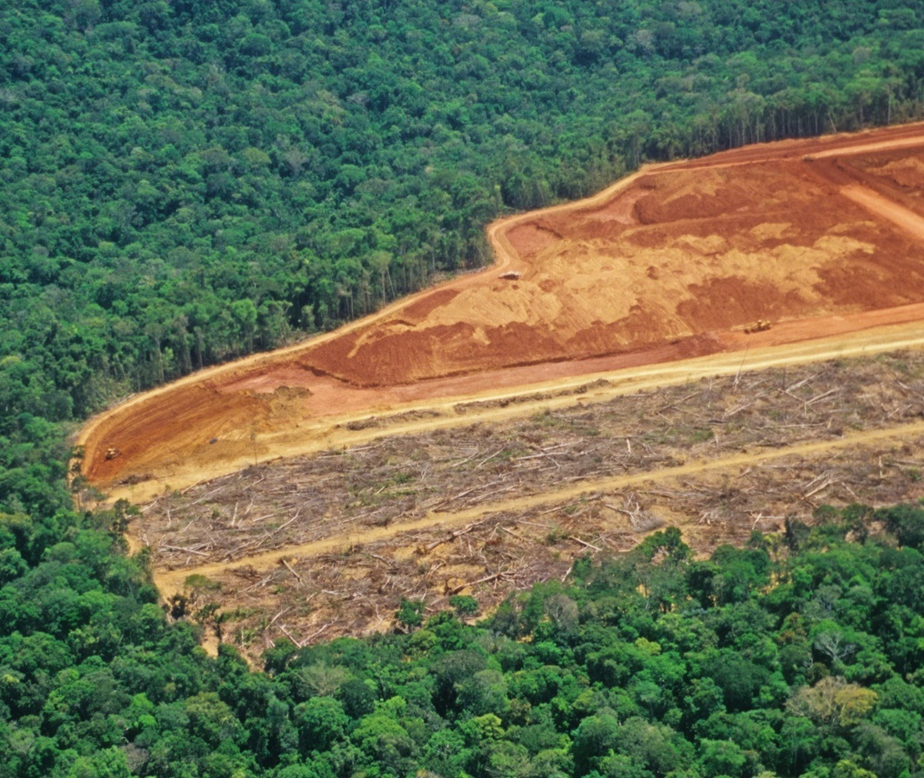
Deforestation and forest degradation
Forests are in serious danger from deforestation and forest degradation; an equivalent of 800 football fields of forest lost every hour
Primary forests particularly at risk
43% of EU land is forest/other wooded land. From 1990 to 2015 forest cover increased by an area the size of Greece.

Slide 3
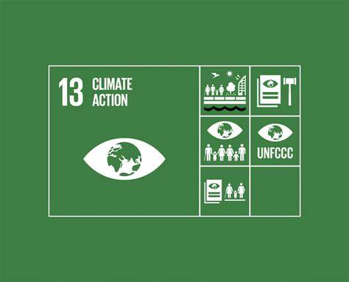
Why does this matter?
Forests are indispensable to address the sustainability challenges of our times (SDGs, Paris Agreements, Convention on Biological Diversity)
Deforestation and forest degradation have major consequences on stability, security, climate, biodiversity, health and livelihoods
12% of all greenhouse gas emissions comes from land-use and land-use change mostly due to deforestation
Forests host 80% of Earth’s land area biodiversity

Slide 4
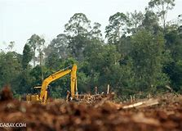
Drivers of deforestation and forest degradation
Direct drivers:
Agricultural expansion (80%)
Urban expansion
Infrastructure development
Mining
Indirect drivers:
Weak policies, weak governance, lack of law enforcement
Lack of integrated planning
Unclear land tenure and land rights
Illegal activities
Lack of investments
Unsustainable exploitation
Natural events (fires, pests)

Slide 5
Role of the EU
The EU is a major importer of commodities associated with deforestation and forest degradation
The EU is thus a key player and shares a global responsibility

Slide 6
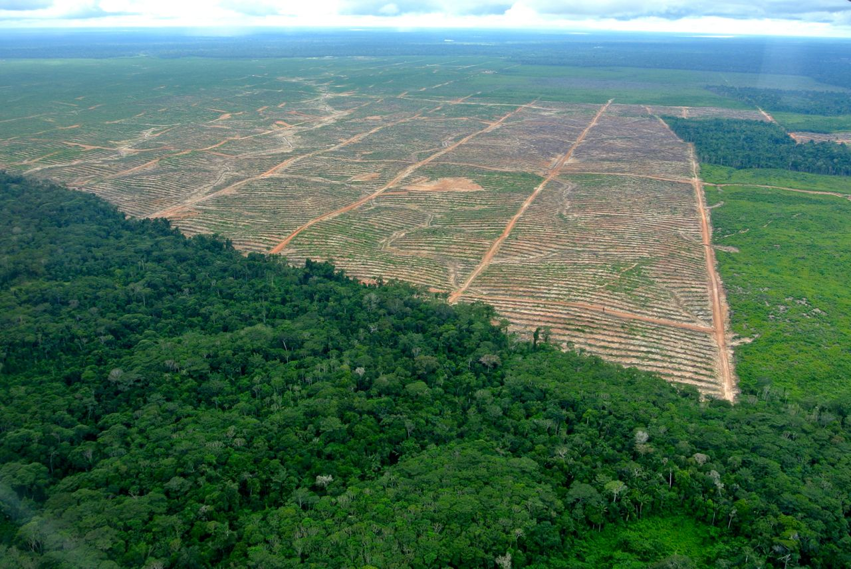
New Communication on Stepping up EU Action to Protect and Restore the World’s Forests
Objective: propose ways to step-up EU action to protect the world’s forests, in particular primary forests, and regenerate forests in an sustainable and responsible way.
Adoption: 23 July 2019
36 actions in 5 priority areas
Recommendations for authorities, industry and civil society
SWD on supporting evidence and consultation activities

Slide 7
5 Priorities for stronger action to protect and restore the world‘s forests
Reduce the EU consumption footprint on land and encourage the consumption of products from deforestation-free supply chains in the EU
Work in partnership with producing countries to reduce pressures on forests and to ‘deforest–proof’ EU development cooperation
Strengthen international cooperation to halt deforestation and forest degradation and encourage sustainable forests restoration
Redirect finance in support of more sustainable land-use practices
Support availability of, quality of and access to information on forests and commodity supply chains. Support research and innovation
1. Sustainable supply chains: demand side
2. Sustainable supply chains: supply side
3. International cooperation
4. Finance and investments
5. Research & transparency, traceability

Slide 8
Reducing the EU consumption footprint
Assess additional demand side regulatory and non-regulatory measures to minimise the risk of deforestation and forest degradation associated with commodity imports in the EU.
Establish platform for multi-stakeholder and Member State dialogue.
Support corporate social responsibility/responsible business conduct practices, voluntary commitments, standards and certification schemes.
Implement EU FLEGT Work Plan 2018-2022, in particular the EU Timber Regulation.

Slide 9
Working with producer countries
Ensure that deforestation is included in political dialogues at country level
Ensure that EU support for policies in partner countries does not contribute to deforestation and forest degradation
Help partner countries to implement sustainable forest-based value chains and promote sustainable bioeconomies
Scale-up support for improved land and forest governance and law enforcement (EU Action Plan against Wildlife Trafficking, FLEGT Work Plan 2018-2022, etc.).

Slide 10
International cooperation; Finance
Cooperate in key international fora, international commodity bodies, and bilateral dialogues with major consumer and producer countries.
Trade agreements: Promote inclusion of provisions on the conservation and sustainable management of forests.
Consider deforestation in the implementation of the Action Plan for Sustainable Finance.
Support producer countries to mobilise public and private financing and ensure its effectiveness.

Slide 11
Research and Innovation
Establish an EU Observatory on deforestation, forest degradation, changes in the world’s forest cover, and associated drivers to facilitate access to information on supply chains for public entities, consumers and businesses.
Continue to support the development of global and regional information systems to monitor the effects of forest fires.

Slide 12
Next Steps
Conference on Forests 4/5 February 2020
Establishing the Platform for multi-stakeholder and Member State dialogue.
Assess additional demand side regulatory and non-regulatory measures.
Establish the EU Observatory.

Slide 13
Thank you ENV-DEFORESTATION@ec.europa.eu Jorge.Rodriguez-Romero@ec.europa.eu

